Slide 1
Circular Flow of Income

Slide 2
Measuring ….
When measuring how well a country is performing a common measurement used is its level of output. Countries can also be compared with each other from this.
Output can be measured in terms of GDP – Gross (total), Domestic (Home), Product (output) or GNP (Gross National Product),
GDP also includes the output of foreign owned firms with production plants located in Australia.

Slide 3
Continued….
GNP = GDP + Net Property Income from Abroad (NPIA)
(NPIA is the net balance of interest, profits and dividends coming into Australia from Australian assets owned overseas matched against the flow of profits and other income from foreign owned assets located in Australia.

Slide 4
Continued…..
There are three ways of calculating GDP, which all should sum to the same amount as they all measure the flow of income produced in an economy.
National Output = National Expenditure = National Income

Slide 5
Circular Flow of Income
The CFY (do not abbreviate in the tests) is a basic model to describe the O, Y & E of an economy.
The CFY depicts the flow of resources, goods and services and income between the different parts of the economy.

Slide 6
Simple CFY
The simple CFY is aka the two sector model.
The two sectors are:
  Households (see next slide)
  Firms (see next slide)
The assumptions made:
  There are only two sectors in the economy
  Households spend ALL their income – they are the holders of the productive resources (F of P) and the buyers of the Goods and Services
  All output produced by firms is sold to consumers
  There is NO saving
  There is NO Government
  There is NO Overseas trade

Slide 7
The Households Sector
The household sector consists of all the individuals in the economy who earn an income.
The income comes from the F of P – rent, wages, interest and profit) by selling the productive resources.
With the money earnt, the households purchase goods and services from the Firms Sector to satisfy their wants or maintain their standard of living

Slide 8
The Firms Sector
The firm sector consists of the private business enterprises in the economy which produce and distribute goods and services to consumers.
The firms buy the productive resources from the Household sector and make factor payments.
Firms attempt to maximise profit by minimising their costs of production and maximising their revenue from sales of goods and services.

Slide 9
Households
Firms

Slide 10
The Economy is in Equilibrium
Income = Expenditure = Output
Y = E = O
Equilibrium is defined as a situation in which there is no tendency for the levels of Y, E or O to change
This means that all households income (Y) is spent (E) on the output (O) of firms, which is equal to the value of payments for the productive resources purchased by firms from households!

Slide 11
This is a Closed Economy

Slide 12
3 Sector Model
Financial Institutions
Why do households save – write a list
Why to firms invest – write a list
Income is either consumed or saved. Y = C + S
Output either produces consumption goods or investment goods. O = C + I
Therefore Actual S = Actual I

Slide 13














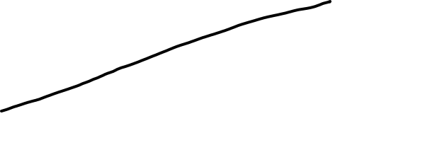

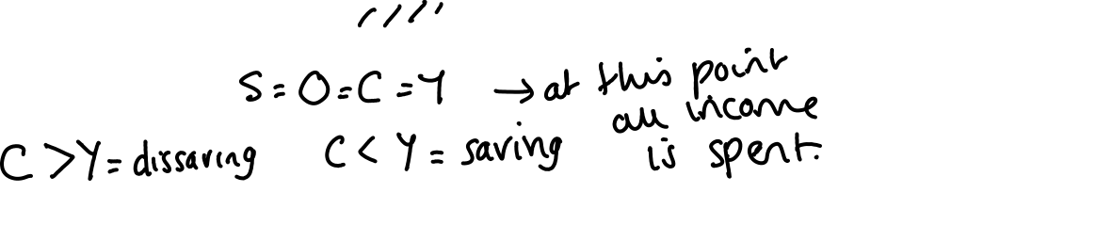


Slide 14



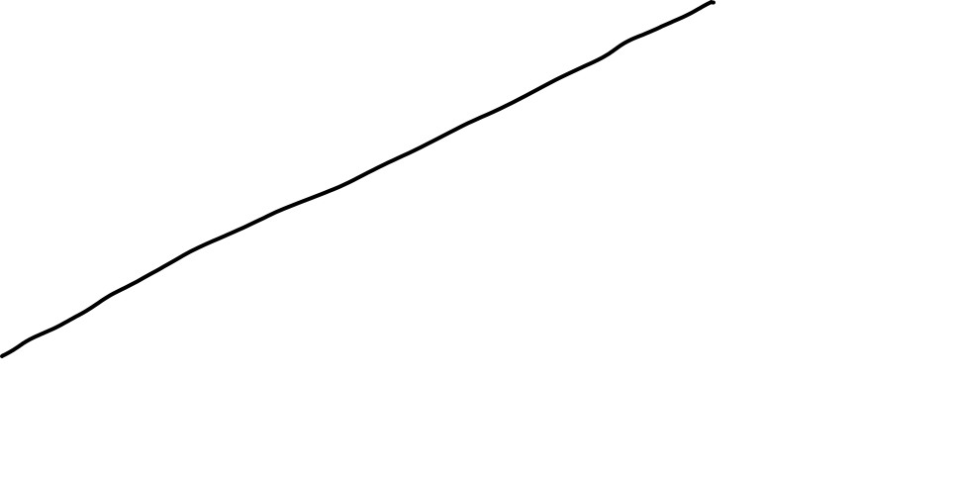




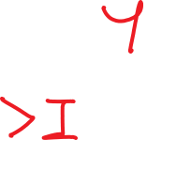



Slide 15
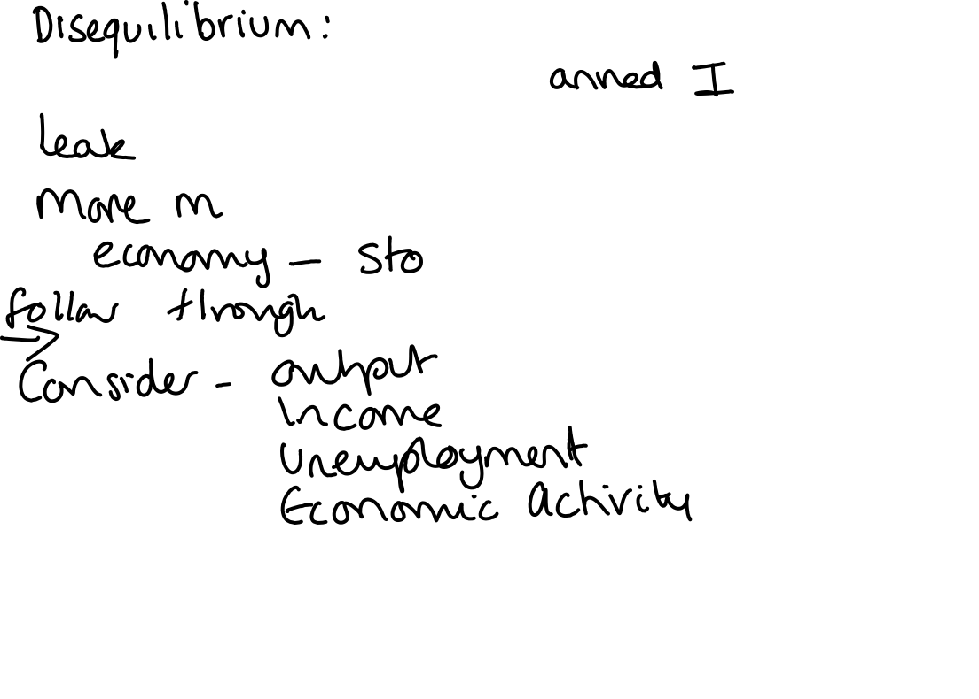
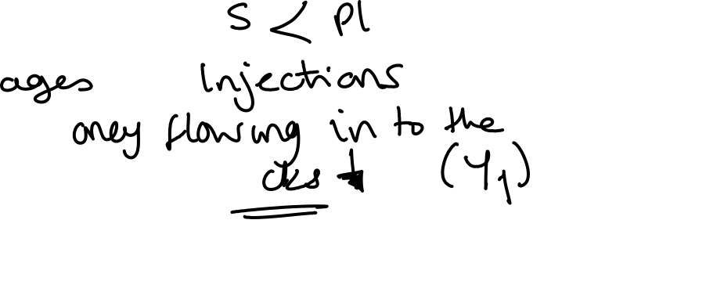



Slide 16
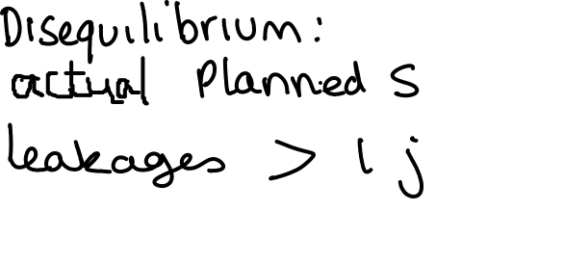
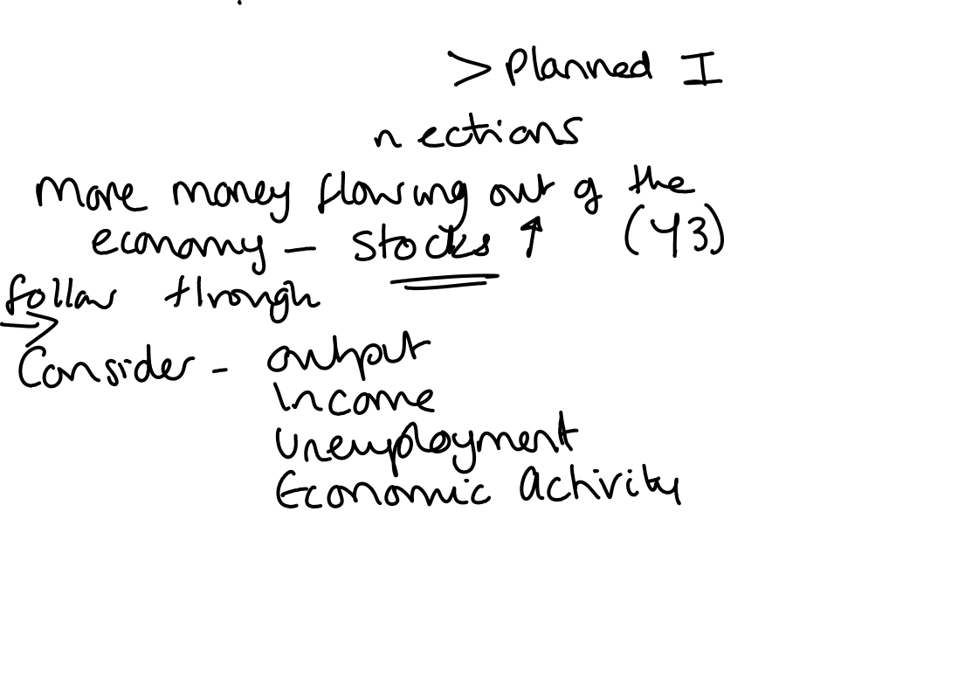

Slide 17
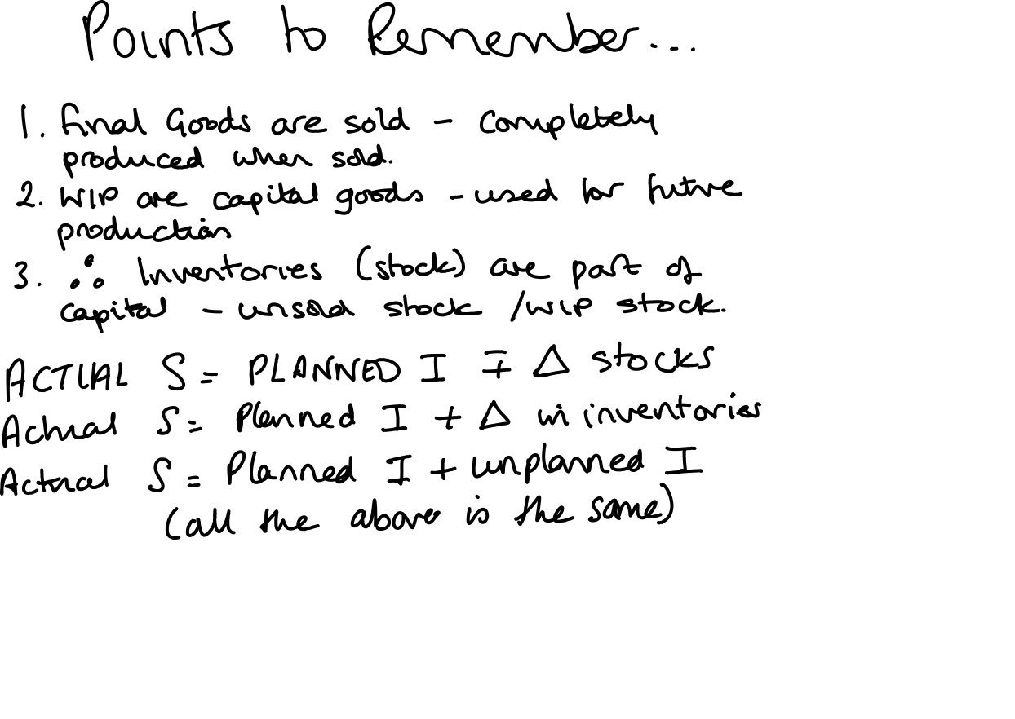

Slide 18













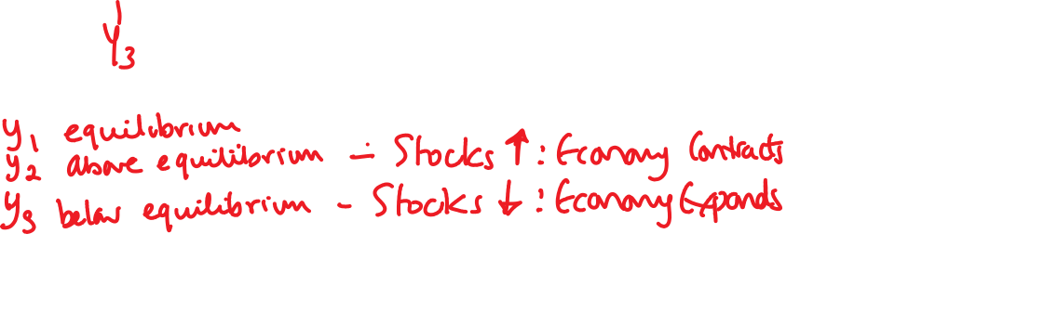

Slide 19
4 sector model
Government
Government charges households taxation. (T) leakage.
Government uses the revenue to inject back into the economy - government spending (G).
Add G to the model

Slide 20




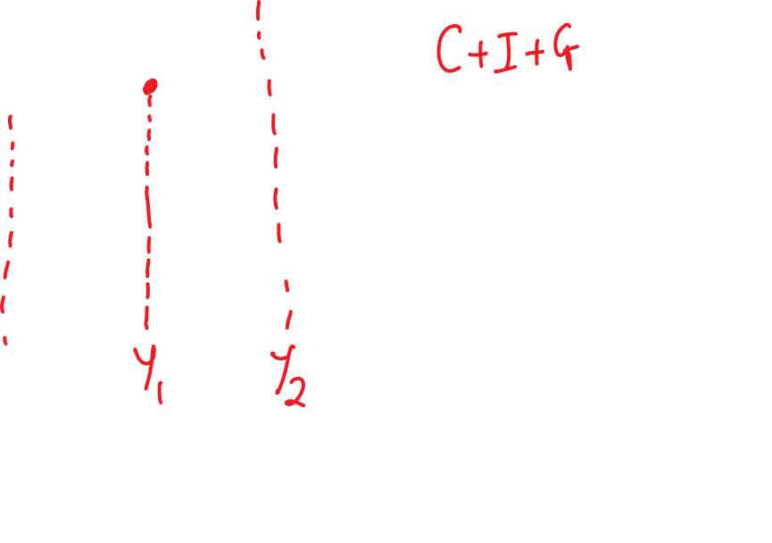





Slide 21
5 sector model
Overseas markets
Exports (X) – goods and services foreign firms buy for domestic markets.
Imports (M) – goods and services domestic markets buy from foreign markets.

Slide 22


